Slide 1

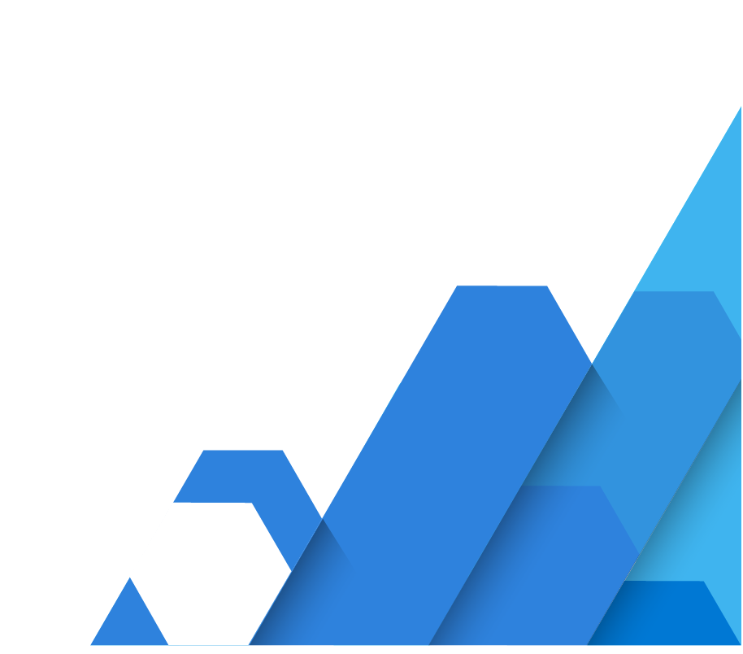
Demand Forecasting Solution Accelerator
Consolidate machine learning models for an end-to-end solution
Solve complex supply chain and sales forecasting challenges efficiently when you use Azure Machine Learning to consolidate your end-to-end forecasting models. The new Demand Forecasting Solution Accelerator enables you to train data from multiple sources to forecast future demand.
With this Demand Forecasting Solution Accelerator, you will learn how to configure your environment, prepare your dataset, train 10,000+ models, and forecast sales. Then you can customize your accelerator for your own specific business challenges.
Customer Challenges
Inability to meet customer demand
Need a 360-degree approach to supply chain
Departments operating in silos
Tremendous time and resources utilized in making supply chain changes
Solution Accelerator Benefits
Easily launch and reduce development time using pre-built, pre-configured solution
Reliable, real-time visibility using custom-built templates that meet customer demands and deliver results within weeks
Get technical support from Azure experts and the Microsoft partner network
“
“The model we deployed on Azure Machine Learning helped us choose the three new retail locations we opened in 2019. Those stores exceeded their revenue plans by over 200% in December, the height of our season, and within months of opening were among the best-performing stores in their districts.”
- Jolie Vitale, Director of BI and Analytics | Carhartt
“
Improve accuracy with “many models” approach
As you train many models in parallel, accuracy increases, and demand forecasting becomes more precise, resulting in a 2% increase in profit margin for every 3% increase in forecast accuracy.
stores
products
Forecasting becomes more precise as the number of models increases
20,000
60,000
120,000
10
100
1,000
states
customer
segments
PRECISION
categories
channels
NUMBER OF MODELS
©2021 Microsoft. All rights reserved.

Slide 2


Customer Success Stories
Carhartt: To remain competitive with the growing number of online retail giants, Carhartt decided to get ahead of the game with a comprehensive data-driven solution. After realizing that their on-premises virtual machines were creating a memory bottleneck, their team worked with Microsoft to expand its model with high-performance solutions from Azure Machine Learning. Supercharged data insights helped Carhartt optimize sales across e-commerce sites, big-box retailers, and its 33 physical stores.
Walgreens: Serving approximately 8 million customers daily requires this retailer to process vast amounts of data daily. Walgreens relies on insights gained by comparing POS transactions to historical data across the supply chain. To make this process even more complex, the retailer acquired other retail pharmacies, adding even more data points to analyze. With Azure, Walgreens was able to use machine learning to connect the disparate sources of data to optimize its inventory and promotions to target the right customers at the right time.
Build an intelligent supply chain within weeks
Gain valuable insights with a smooth, personalized experience using the Solution Accelerator journey below:
Kick-off
Proof of value
MVP & Deployment
Learn more about the Demand Forecasting Solution Accelerator and see a demo
Solution code walk-through and prototype creation for customer testing
Minimum Viable Product (MVP) is built and deployed for the customer with support of the technical specialists (CSA) and Partners
With demo data, create your MVP in less than a day
With your custom data and a prep session, create your MVP in 2-5 weeks
How to get started
Contact your Microsoft specialist for a demo and to discuss prerequisites, next steps, and your questions.
©2021 Microsoft. All rights reserved.

